Slide 1
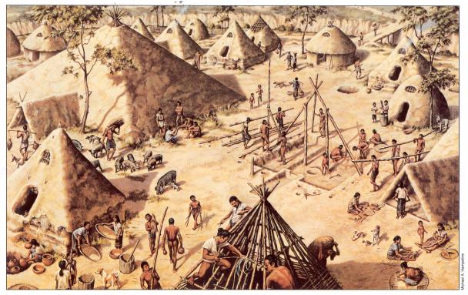
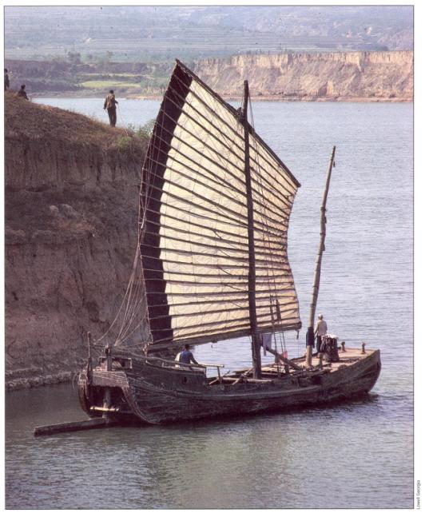
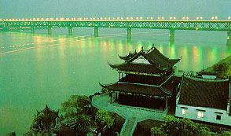
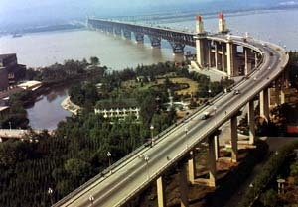
Chapter 2: (See your Packet, p. )
“The Four Early River Valley Civilizations”
Mesopotamia [Sumer] (Tigris & Euphrates Rivers)
Egypt (Nile River)
Indus Valley (Indus River)
Ancient China (Huang He River)
ENTER
A Chinese junk on the Huang He today.
An artist visualizes what the ancient Chinese village of Banpo
on the Huang He may have looked like over 4,000 years ago.
PP Design of T. Loessin; Akins H.S.

Slide 2
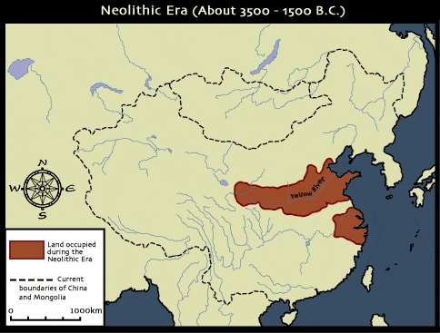
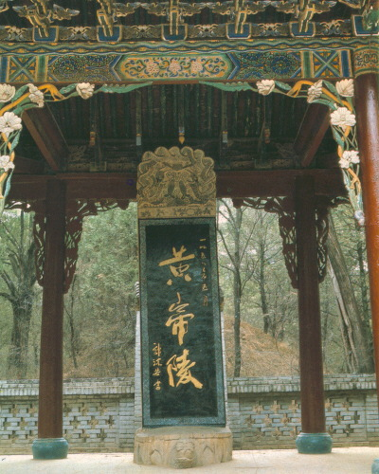
Chinese script is unique, isn’t it?
Think about other elements of Chinese culture:
Chinese architecture, music, technology,
dress and fashion, and eastern belief systems…
Also unique!
Gobi Desert
Taklimakan Desert
Himalaya Mts.
Pacific Ocean
CH 2: “River Dynasties in China” [Packet, p. ]
1. Why did China develop apart from other cultures?
China’s geography ocean, desert, high mountains, isolated China.
Isolated geographically, cut off from trade, there would be little opportunity for cultural diffusion in
China’s case. Developing in a vacuum, China’s civilization would stand out as the most unique of our world’s early civilizations.
PEACE
LOVE
TOLERANCE
LUCK
ETERNITY

Slide 3
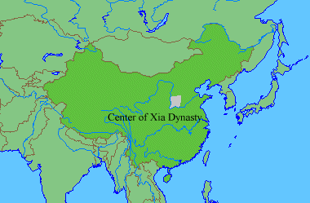
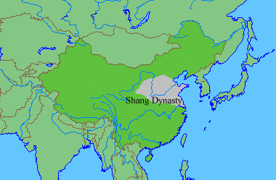
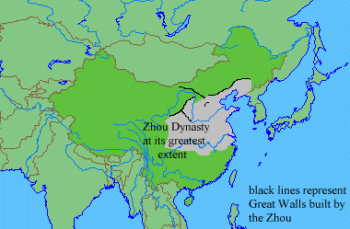
Ancient
China
Neolithic ca. 12,000 - 2000 B.C.
Xia ca. 2100-1800 B.C.
Shang 1700-1027 B.C.
Western Zhou 1027-771 B.C.
Eastern Zhou
770-221 B.C.
Warring States period
475-221 B.C.
PP Design of T. Loessin; Akins H.S.

Slide 4
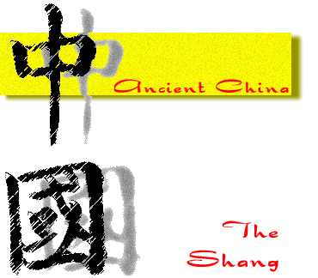
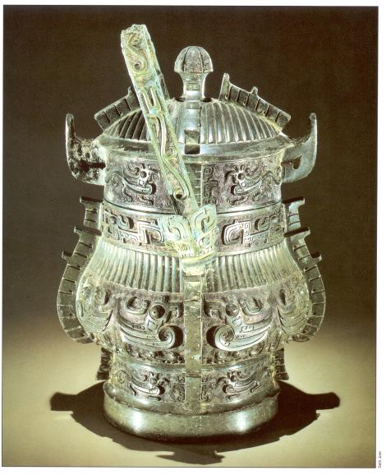
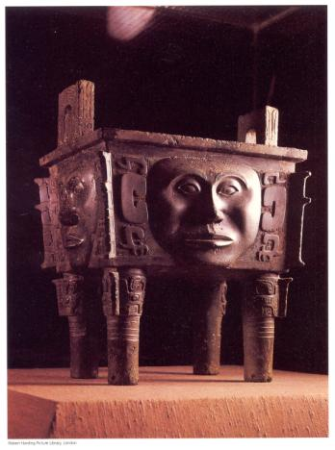
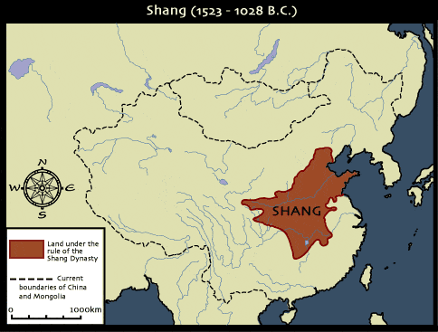
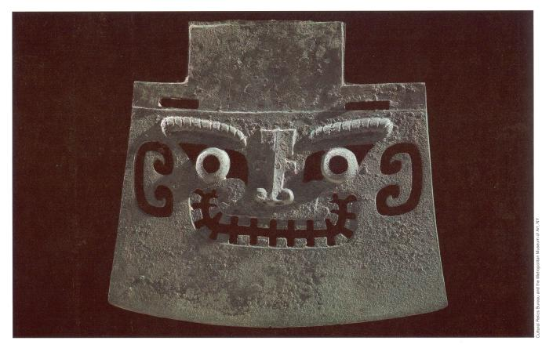
CH 2: “River Dynasties in China” [Packet, p. ]
2. What were three features of Shang culture?
First written records
- calligraphy writing and paper making
Sharp division between king’s nobles and the
peasants
Wood used as building material
(not mud-dried bricks as in other regions)
Peasants used wooden tools
Shang made magnificent bronze weapons
and ceremonial vessels
Pics: Bronze work of the Shang period (1700-1027 B.C.).
A toilet, an ax, and a cooking cauldron.
PP Design of T. Loessin; Akins H.S.

Slide 5
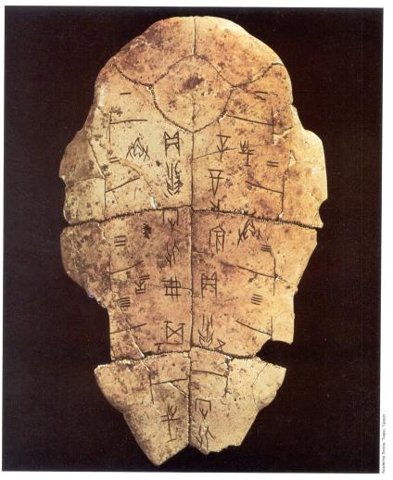
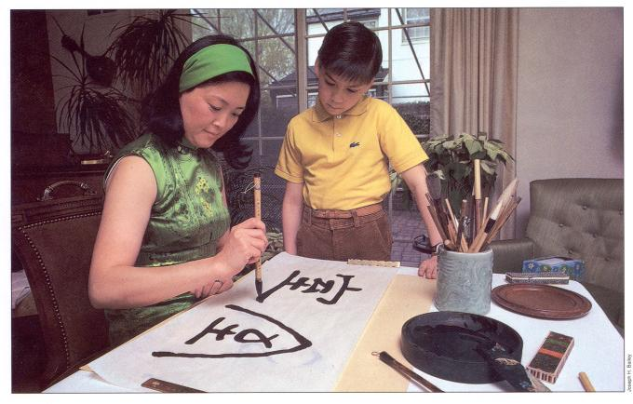
CH 2: “River Dynasties in China” [Packet, p. ]
3. Name three important values of Shang culture.
From very early on, the idea of the “group” /
community more important than the idea of
“individual”/ or any single person.
Emphasis on family, respect of parents
Family emphasized in religion too –
ancestor worship.
Oracle bones used to consult the gods
Chinese writing unique to others.
Symbols stood for ideas, not sounds.
This allowed the many different groups who
spoke different languages to all understand
the same writing system.
Oracle bone
PP Design of T. Loessin; Akins H.S.

Slide 6
Ancient
China
Neolithic ca. 12,000 - 2000 B.C.
Xia ca. 2100-1800 B.C.
Shang 1700-1027 B.C.
Western Zhou 1027-771 B.C.
Eastern Zhou
770-221 B.C.
Warring States period
475-221 B.C.
PP Design of T. Loessin; Akins H.S.

Slide 7
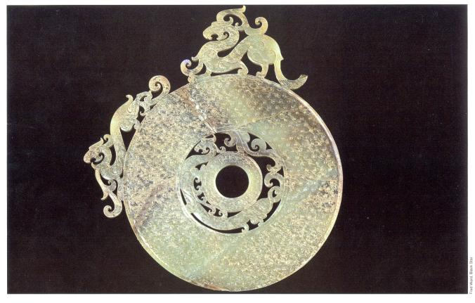
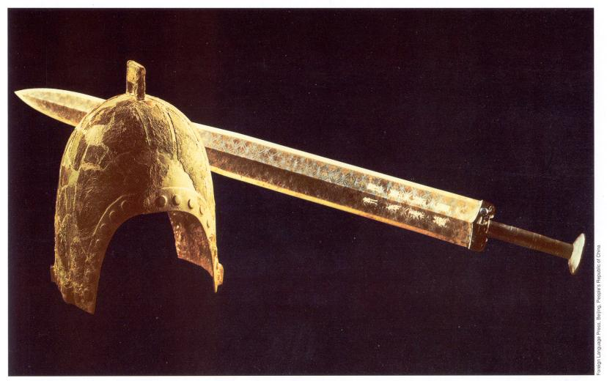
CH 2: “River Dynasties in China” [Packet, p. ]
4. Name two important changes brought about by
the Zhou.
While the Zhou did simply adopt much of old Shang culture, they also did introduce new things:
A new idea of royalty that claimed rulers got their
authority from heaven. This was known as the
Mandate from Heaven.
From this time on the Chinese would believe in
divine rule.
This meant disasters could be blamed on the rulers
and they would frequently be replaced.
This led to a pattern of rise and fall of dynasties in
China known as the dynastic cycle.
The Zhou gave large regions of land and privileges to
a select few nobles who then owed loyalty to the king
in return. This type of political system the Zhou
introduced is called feudalism.
Zhou introduced the first coined money; improved
transportation with roads and canals; improved the
efficiency of government with trained workers called
civil servants; and introduced the first iron-making.
Above: Jade disk,
China’s Zhou period.
Below: Bronze helmet and sword,
Zhou period.
PP Design of T. Loessin; Akins H.S.

Slide 8
Ancient
China
Neolithic ca. 12,000 - 2000 B.C.
Xia ca. 2100-1800 B.C.
Shang 1700-1027 B.C.
Western Zhou 1027-771 B.C.
Eastern Zhou
770-221 B.C.
Warring States period
475-221 B.C.
PP Design of T. Loessin; Akins H.S.

Slide 9
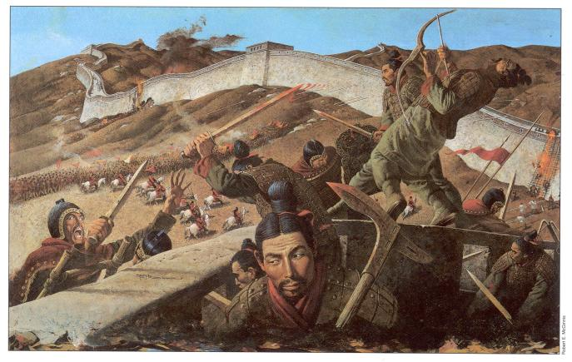
The first 300 years of Zhou rule were relatively peaceful and stable.
But that changed around 771 B.C.E. as nomadic tribes invaded from the north and as the noble families began to fight for power against one another.
The crossbow is introduced in China during this time of great conflict and chaos known as the Period of Warring States.
Chinese values collapsed during this period of arrogance, chaos, and defiance.
Will China be saved?
By who?
…..stay tuned.
PP Design of T. Loessin; Akins H.S.

